Slide 1
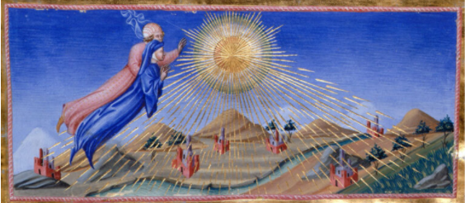
Beyond Flatland – Transformative Ways of Knowing
Louise Livingstone, PhD
Goethean Enquiry & Heart Sense

Slide 2
Goethe said, ‘If you cannot find words to describe it you are on the right path.’ Einstein commented, ‘The most beautiful thing we can experience is the mysterious, it is the source of all true art and science.’ Krishnamurti taught that releasing ourselves from the grip of ‘what we know gives a sense of boundless freedom.’ (Stirk, 2015, p.11)
Kripal – “a radically new real can appear with the simplest of ‘flips’, or reversals of perspective, roughly, from ‘the outside’ of things to ‘the inside’ of things….That moment of realization beyond all linear thought, beyond all language, beyond all belief, is what I call ‘the flip’. It is a very big deal. Such a flip is often sudden, unbidden, or traumatically catalyzed. It is also beautifully, elegantly simple.” (2019, pp. 12-13, italics in original)

Slide 3
Session Outline
Context
Short meditation
Practical exploration
Revelatory experience with my heart:
“Please, please stop this! You’re killing me! This conflict is your own creation yet you also have the power to change it.”

Slide 4
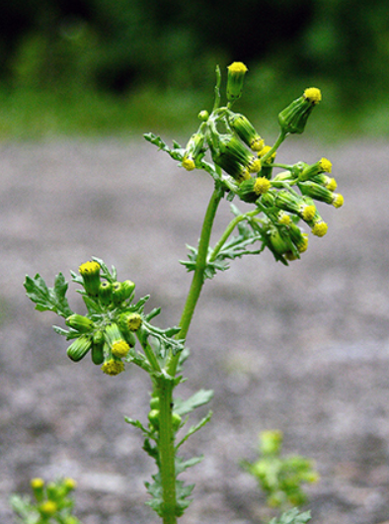
Goethean Enquiry – opening to ‘something more’
Johann Wolfgang von Goethe (1749 – 1832)
All is in the phenomenon. There is nothing hidden, one simply needs to carefully cultivate one’s mode of perception:
Step one: exact sensorial perception – studying phenomena as clearly and deeply as possible, without pre-formed mental models, theories and classifications. Listen closely and observe
Step two: exact sensorial imagination – recreating the experience in his imagination to come to know phenomena better
Notes:
My doctorate and ongoing research, endeavours to respond meaningfully to archetypal psychologist James Hillman’s (1926 – 2011) lament that in contemporary society we are bereft of an adequate psychology and philosophy of the heart.
However, this does not mean that such an explanation is adequate; particularly in relation to how we make meaning in, and consequently engage in, the complexity of our world.

Slide 5
Heart Sense
An approach arising out of conversations with my heart – made possible by depth psychologist Robert Romanyshyn’s imaginal methodology
Space to for my heart to speak to me through:
Transference dialogues
Reveries
Dream images
Spontaneous images
Bodily sensation
Heart Sense – “insightful perception and considered discernment regarding daily life developed through the wisdom of, and benevolent qualities associated with, the heart” (Livingstone, 2019, p.255)

Slide 6
Notes:
Connect to heart, move beyond the rational mind; to accept the world’s invitation
Show that the heart is the mediator between the sensible

Slide 7
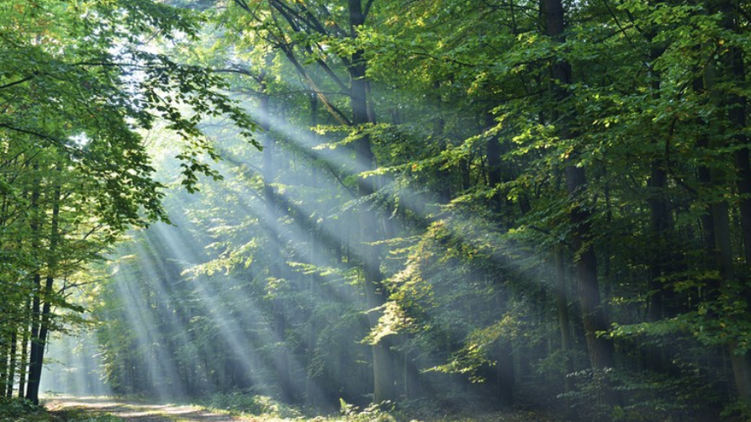
Andreas Weber, “trees…qualify as symbols of life because in our experience they really are life. After a symbolic death in winter they burst into green again. They grow, bloom, and bear fruit, without any involvement whatsoever from us” (2016)

Slide 8
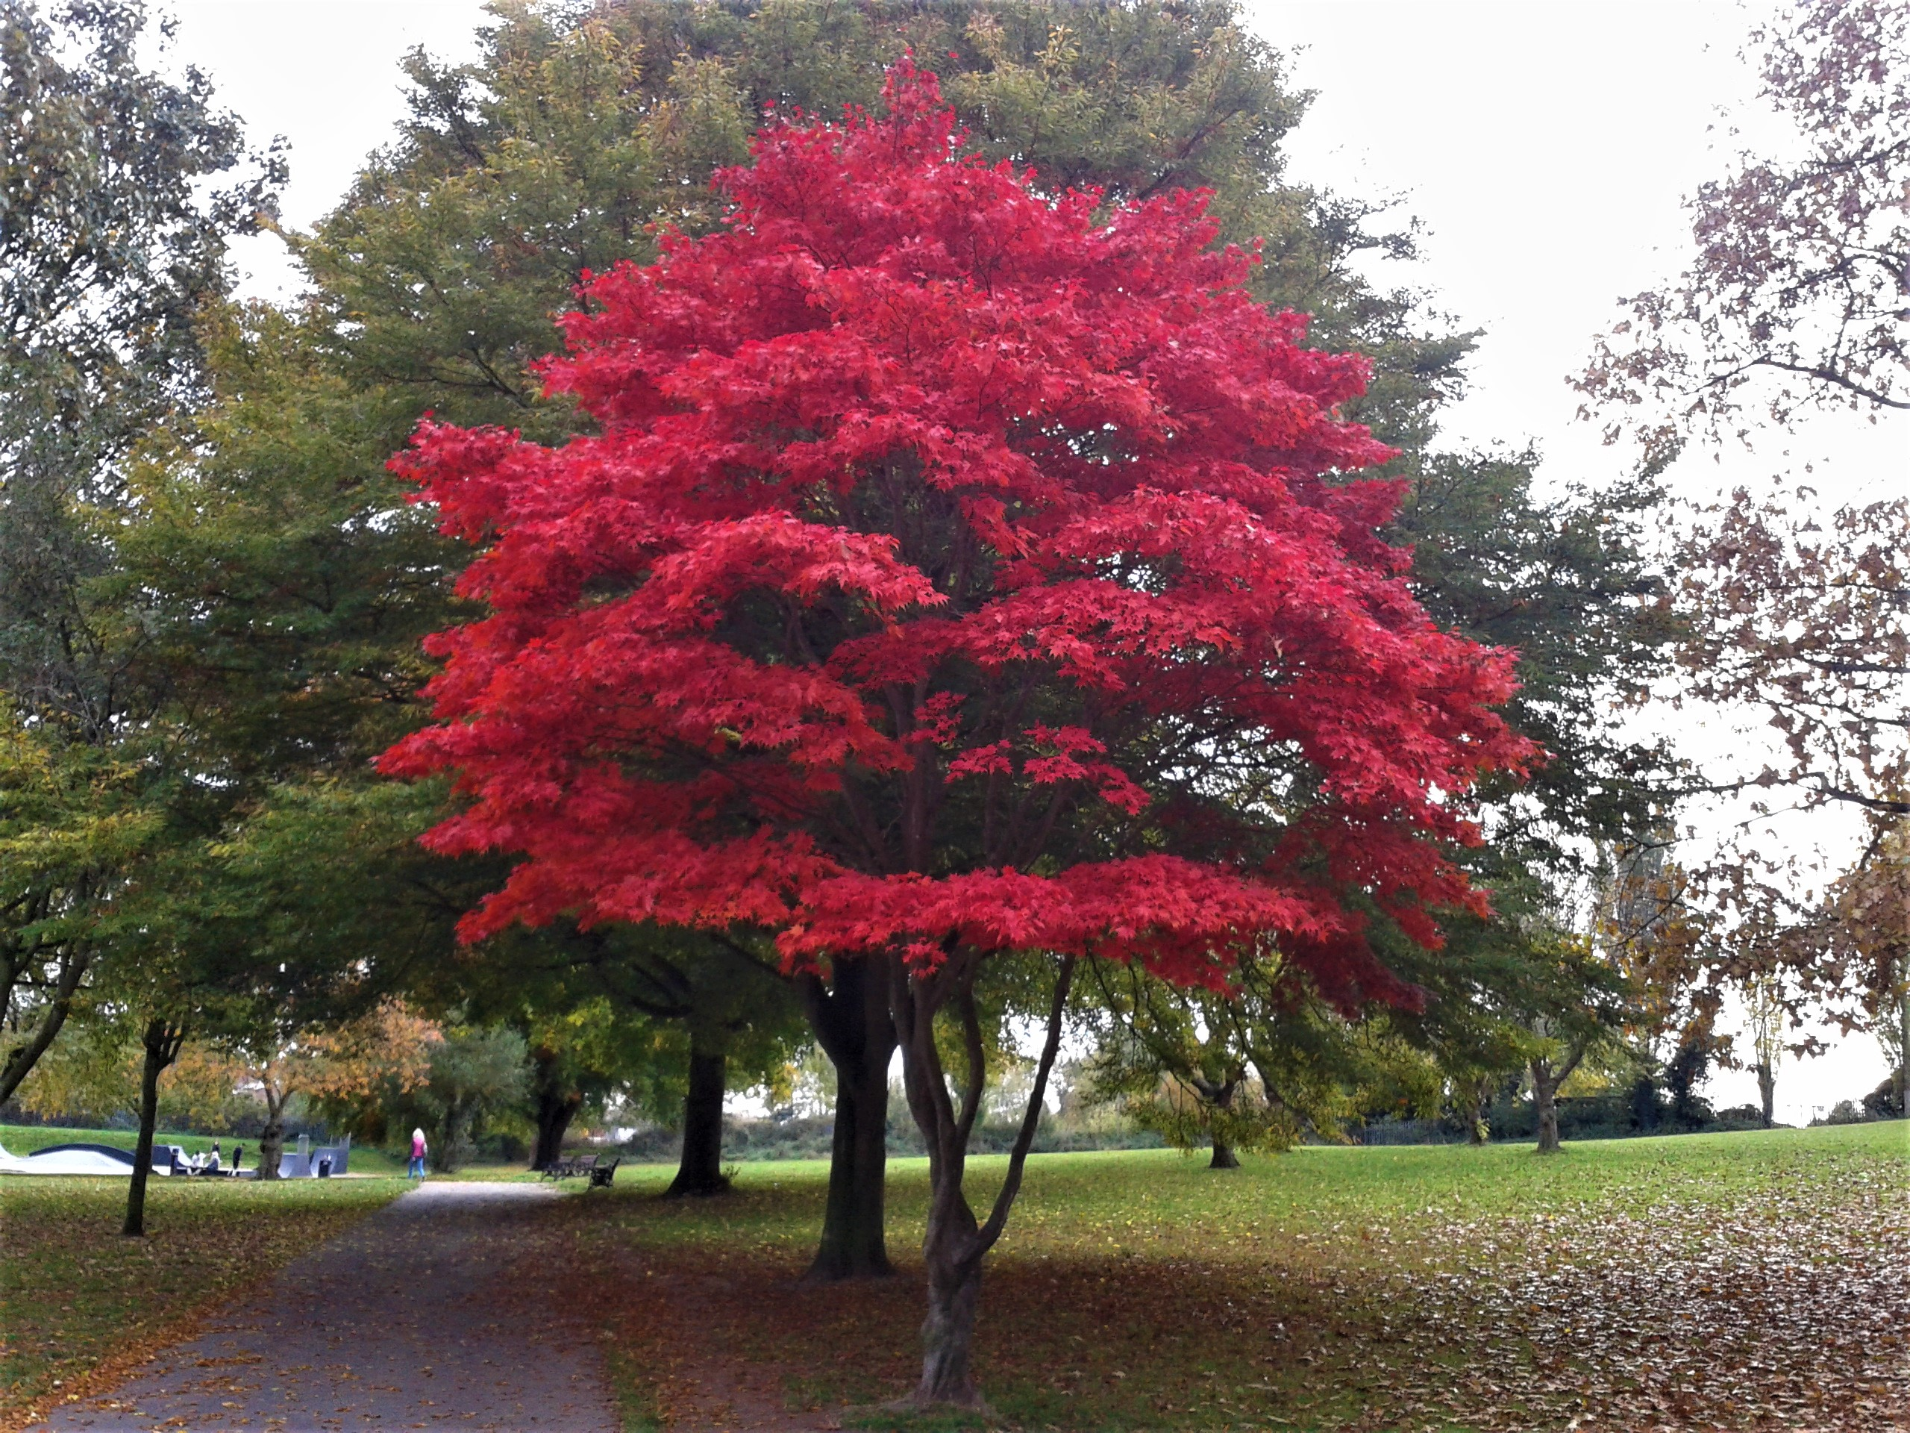
Contemplation
1. Sink into your heart - physically feel your heart’s qualities: openness, love, compassion, kindness.
2. From your heart-space, come into a living relationship with the tree without any pre-formed mental models or theories.
3. Remain in your heart-space & cultivate a sense of curiosity. Encourage the tree to tell its story & reveal itself to you.
4. Listen carefully & deeply with your heart. What can you feel, hear, see & sense?
5. Recreate your interaction with the tree in your imagination – from your heart-space. What do you particularly remember? What, if anything, surprised you?
* Adapted from Heart Sense Process in Livingstone (2019)
Notes:
In this sense, we have lost connection to our authentic hearts; the deeper heart beyond the physical organ (whatever this heart may be).

Slide 9
Transformation
“[T]he thought of the…heart invites us to kindly and courageously break free from the rational ties that bind us, risk ourselves, imagine bravely, and step openly into the dance of life….We have nothing to lose, and everything to gain” (Livingstone, 2019, p.302)

Slide 10
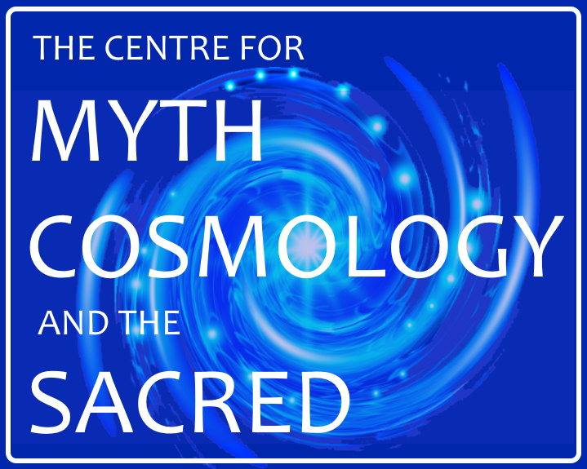
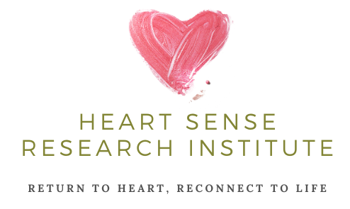
Thank you for taking part today…
www.mythcosmologysacred.com
www.heartsenseresearch.co.uk
Heart Sense personal development groups via Zoom, beginning 1st February 2021 (fortnightly, 7.30 – 9pm). For more information & to express your interest, please email: louiselivingstone@heartsenseresearch.co.uk

Slide 11
References
Corbin, H. (1997) Alone with the Alone: Creative Imagination in the Sufism of Ibn Arabi. New Jersey: Princeton University Press.
Hillman, J. (2007) The Thought of the Heart and The Soul of the World. 5th reprint. New York: Spring Publications.
Holdrege, C. (2005). Doing Goethean Science. Janus Head, 8 (1), 27–52
Kripal, J. (2019) The Flip: Epiphanies of Mind and the Future of Knowledge. New York: Bellevue Literary Press.
Livingstone, L. (2019) How can the thought of the heart offer effective ways of engaging with conflict? An imaginal and reflexive study. PhD. Canterbury Christ Church University.
Naydler, J. (2009). Goethe on Science – An Anthology of Goethe’s Scientific Writings. Edinburgh: Floris Books.
Romanyshyn, R. (2013) The Wounded Researcher - Research with Soul in Mind. New Orleans: Spring Journal Inc.
Stirk, J. (2015) The Original Body - Primal Movement for Yoga Teachers. Scotland: Handspring Publishing.
Weber, A. (2016) The Biology of Wonder – Aliveness, Feeling and the Metamorphosis of Science. British Columbia: New Society Publishers

